Slide 1
MANY 110 EV
FEATURES

Slide 2
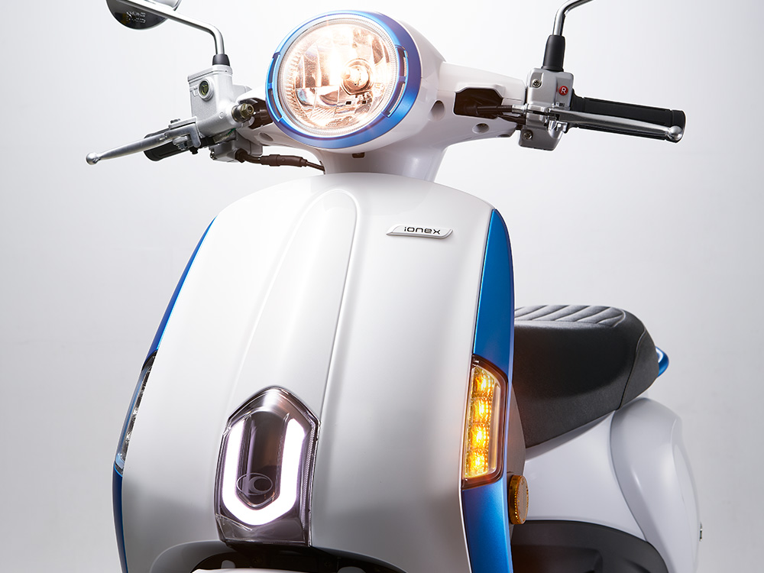
Retro Round Headlights

Slide 3
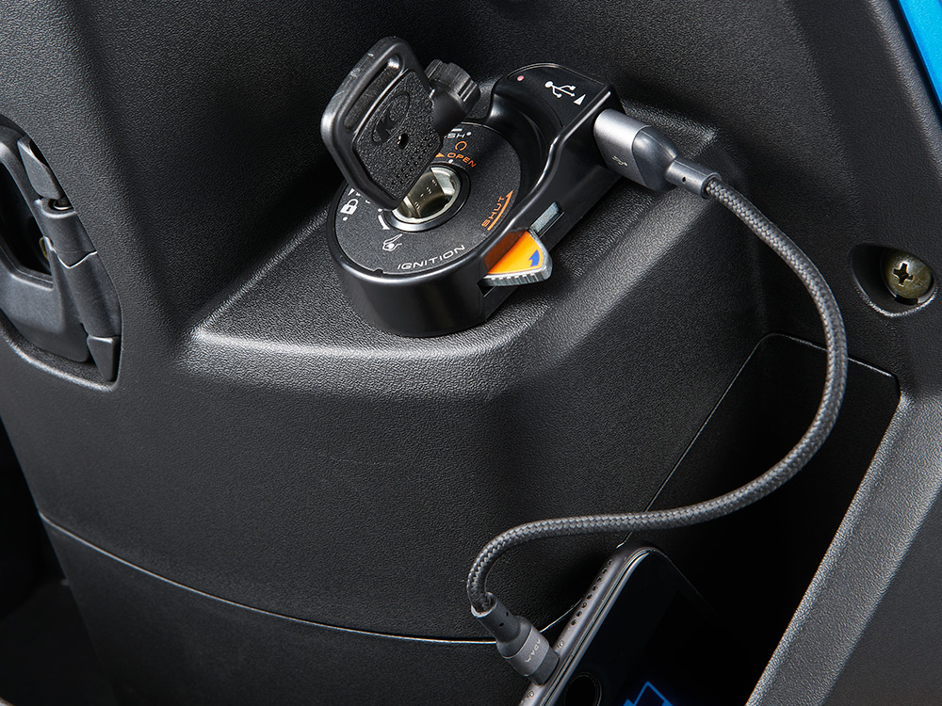
New USB

Slide 4
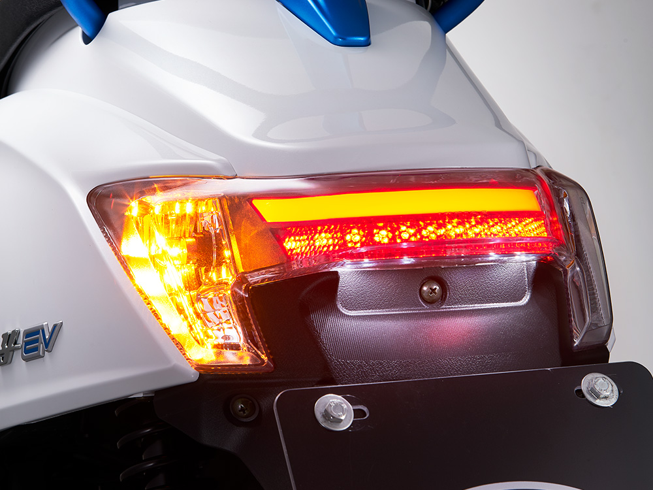
LED light guide bar bright rear light

Slide 5
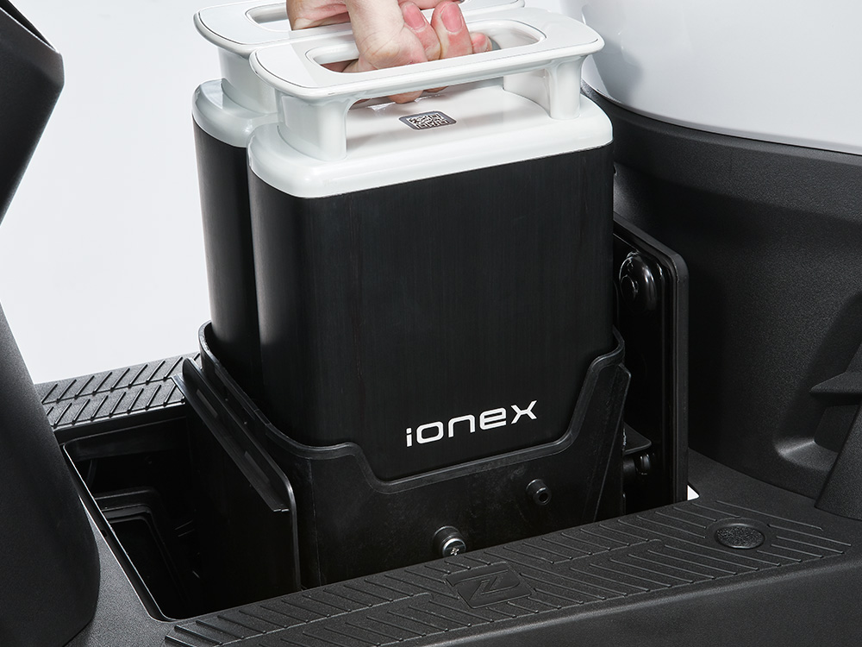
Ionex smart battery extraction (high-profile cool)

Slide 6
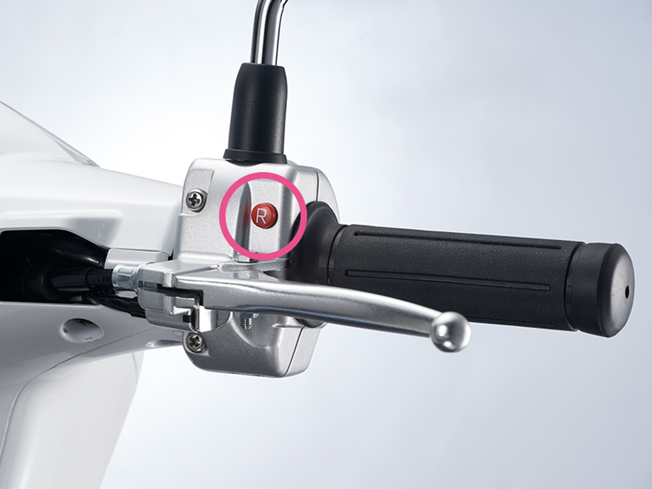
Intimate design and effortless reversing function

Slide 7
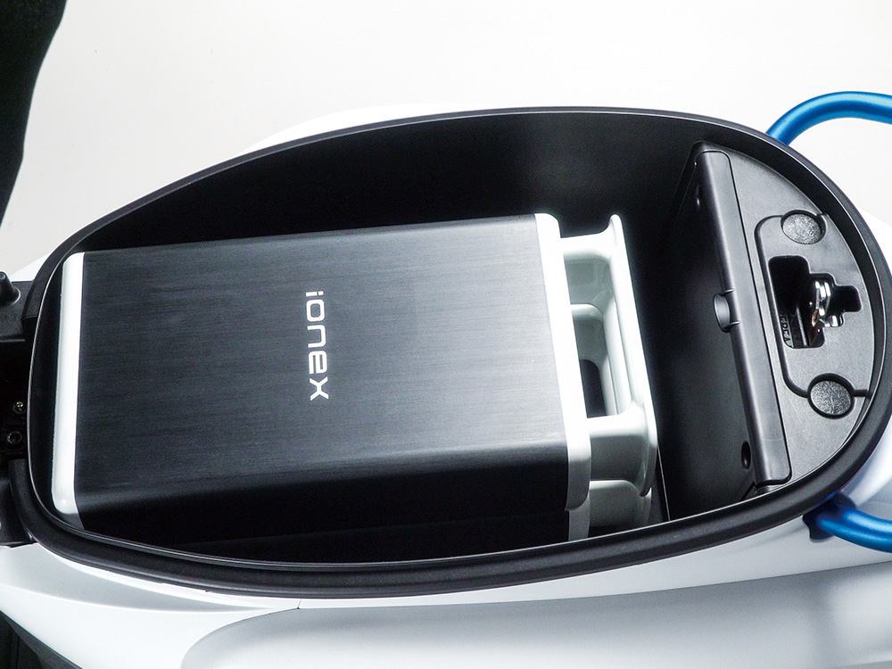
Functional Equipment

Slide 8
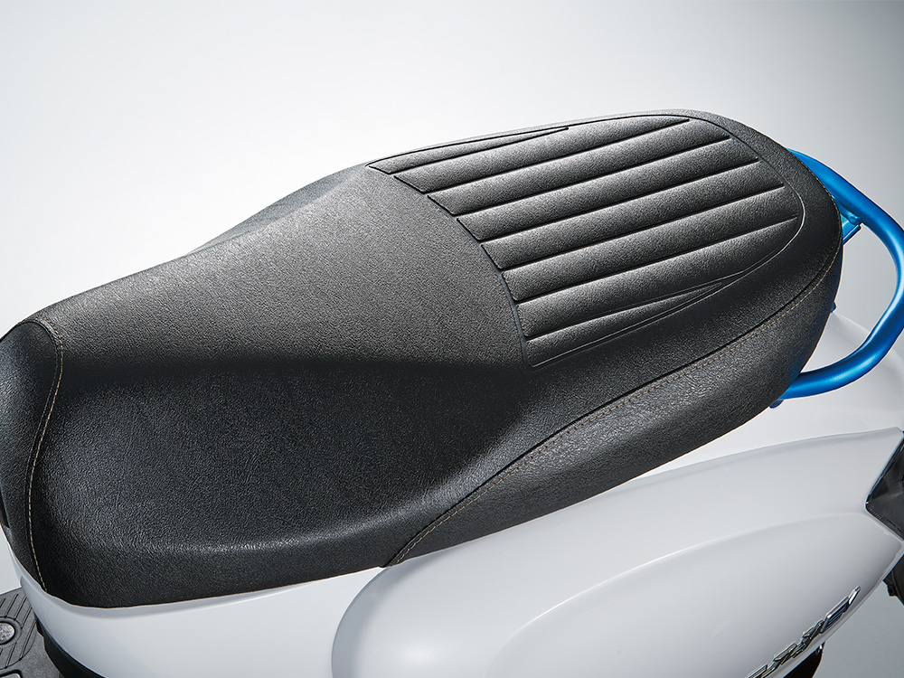
Ergonomic Cushion

